Slide 1
Blockchain, Cryptocurrencies, and Security
For John Jay FCM 740 by Mike Fernez

Slide 2
Cutting through some confusion...
Digital currency-an intangible form of money issued by developers for use within a virtual community
e.g. Ven, Amazon Coin, Nintendo points, Warcraft Gold
Cryptocurrency-a digital currency utilizing cryptography to secure and verify transactions
e.g. Bitcoin, Ethereum, Monero
Blockchain-an open P2P distributed database system that records blocks of data in a way which is verifiable and cryptographically secure
e.g. not only cryptocurrencies but general purpose data systems such as Hyperledger which powers medical databases, anti-fraud software, i-voting and e-government systems
https://en.wikipedia.org/wiki/Blockchain
https://www.hyperledger.org/about

Slide 3
The Mysterious Birth of Blockchain
Prior to Bitcoin in the 90s, there were some attempts to describe and implement digital cash by researchers who communicated through the cypherpunk mailing list
incl. Ecash (David Chaum), hashcash (Adam Back, Hal Finney), bit gold (Nick Szabo) powered by proof-of-work algorithms
The first citation of the Bitcoin paper is a link to a text document on Wei Dai’s research website describing “b-money,” a hypothetical money that could exist in a community without government and the protocols which could realize it.
Inspired by Tim May’s “Cyphernomicon” and “Crypto-Anarchist Manifesto”
In 2008, a white paper from an author by the name “Satoshi Nakamoto” was posted to a cryptography mailing list
Though there have been many claims, no one knows who Nakamoto is
The first real-world Bitcoin transaction was made by Laszlo Hanyecz in Florida: 10,000 BTC for two pizzas from Papa John’s (~$80 mil today)
https://en.wikipedia.org/wiki/History_of_bitcoin
https://www.wired.com/2011/11/mf_bitcoin/
https://www.cypherpunks.to/faq/cyphernomicron/cyphernomicon.html

Slide 4
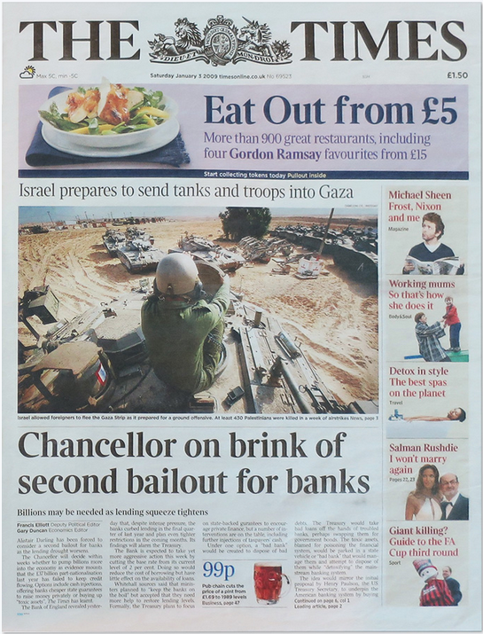
The Mysterious Birth of Blockchain
This paper proposed two foundational ideas. Bitcoin, the cryptocurrency, and the blockchain it’s engine
This paper came shortly after the 2008 financial crisis when trust in financial institutions was at an all time low
The Genesis block has the text: “The Times 03/Jan/2009 Chancellor on brink of second bailout for banks.”
https://en.bitcoin.it/wiki/Genesis_block
http://www.thetimes03jan2009.com/

Slide 5
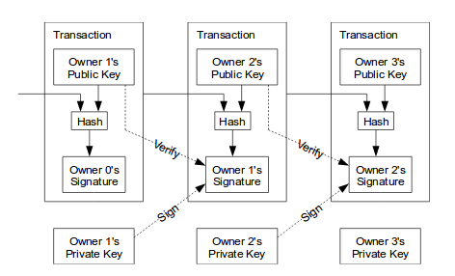
The Nuts and Bolts of the Bitcoin Blockchain: Transaction Chain
Nakamoto defines an electronic coin as “a chain of digital signatures.”
This ensures the transaction is secure, but provides no method of validation
https://bitcoin.org/bitcoin.pdf

Slide 6
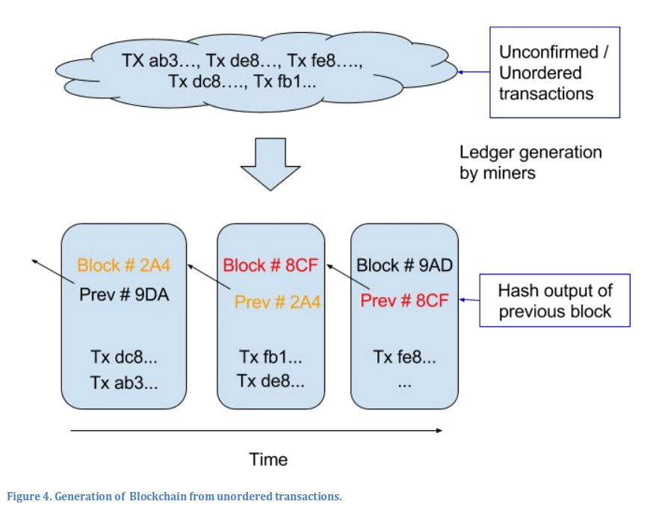
The Nuts and Bolts of the Bitcoin Blockchain: Timestamp Network
The solution is to announce transactions to the entire network, order them, and then publish them permanently
The process of sorting and validating blocks is handled by miners
http://scet.berkeley.edu/wp-content/uploads/BlockchainPaper.pdf

Slide 7
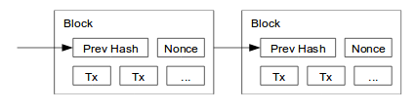
The Nuts and Bolts of the Bitcoin Blockchain: Proof-of-Work
Proofs-of-work are the mechanism that govern how blocks are added and how miners get rewarded
A proof is achieved by miners looking for a number (n) that, with the hash of the block (b), yields a hash with a certain number of zero-bits (x)
Informally: when H(proposed block+newest block+n) = x
Finding the number is a hard problem, but verifying is just one hash
Bitcoin goes to the first CPU to solve it
A dishonest node trying to change the record cannot do so without re-doing the work of the block and every block added after that
https://bitcoin.org/bitcoin.pdf
https://en.bitcoin.it/wiki/Proof_of_work

Slide 8
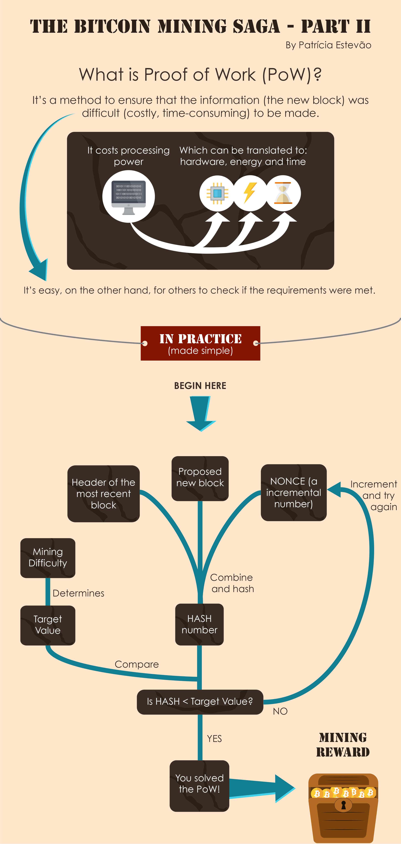
The Nuts and Bolts of the Bitcoin Blockchain: Proof-of-Work
https://www.bitcoinmining.com/what-is-proof-of-work/

Slide 9
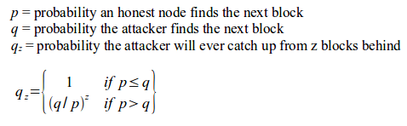
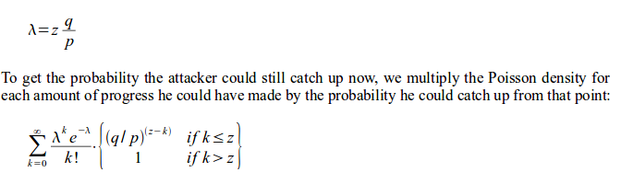
The Nuts and Bolts of the Bitcoin Blockchain: Network Integrity
As long as the network is distributed enough, any single attack on the network won’t affect the availability of the blockchain
In a formal proof, Nakamoto considers an attacker trying to broadcast a competing chain, allowing him to spend again
The probability of the attacker catching up decreases exponentially the longer the chain

Slide 10
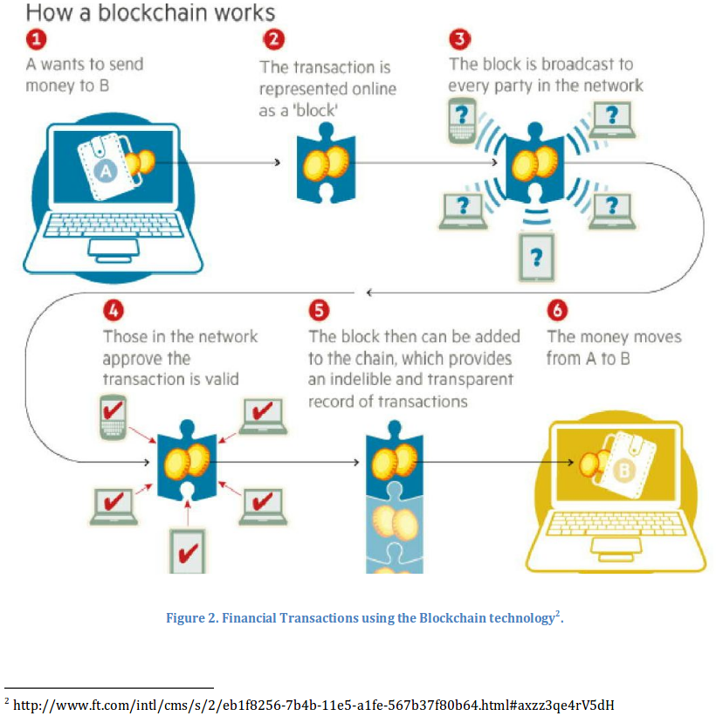
All in all...

Slide 11
All in all...
The blockchain, provides Bitcoin transactions with layers of security:
Relative Anonymity (wallets are public keys)
Creates an immutable record of transactions
Network is distributed enough to resist attacks
The Bitcoin protocol also encourages fair play by design:
The cost of CPU resources to defraud the ledger far outweighs the benefit one would gain from mining

Slide 12


A Brief Look At Cryptocurrencies
“a general purpose blockchain”
Ethereum is a distributed virtual machine platform, designed to be programmable so it can execute smart contracts
“Ether” is the system’s currency
Currently hosts 1241 blockchain-based projects (including organizations like bitnation and games like cryptokitties)
https://www.youtube.com/watch?v=WSN5BaCzsbo
https://www.stateofthedapps.com

Slide 13
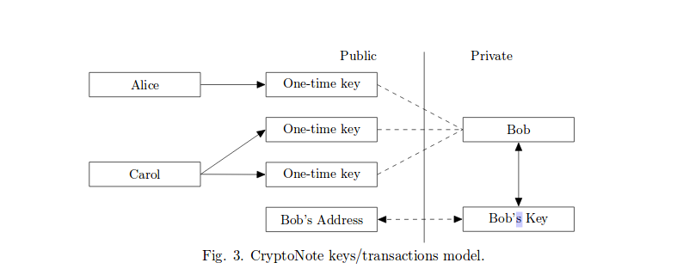

A Brief Look At Cryptocurrencies
Monero (originally CryptoNote)
A cryptocurrency designed for secure and anonymous transactions
Utilizes a process called a “one-time ring signature” to obscure transactions.
From the white paper review on Monero’s site:
We can imagine the CN protocol as a post-office-box system. Each user has a set of public keys and private keys, just like in the BTC protocol. Rather than sending CrytpoNote directly to each others public keys, users execute a Diffie-Hellman exchange and create ring signatures to make a new one-time post-office-box at which the CNs are stored. And when we send our CN,we include our key image, which is just the hash of the private destination key that gave us the right to send those CN in the first place. If that key image has not yet been used, then that one-time ring signature has not yet been spent.

Slide 14
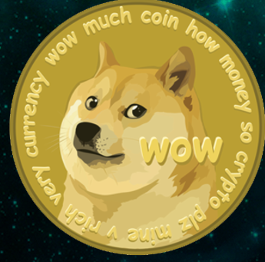

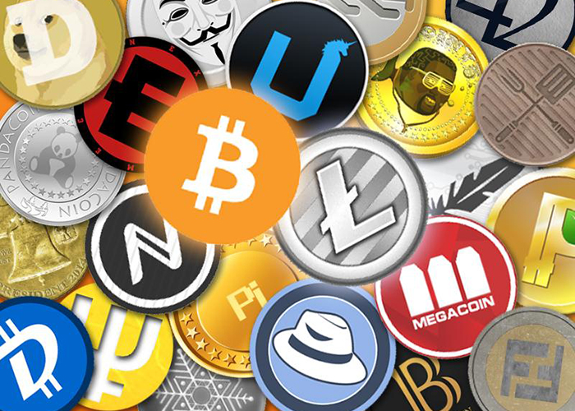

A Brief Look At Cryptocurrencies
A million more...
https://www.irta.com/wp-content/uploads/2016/02/cryptocurrency-01.jpg
https://i2.cdn.turner.com/cnnnext/dam/assets/140223132422-irpt-dogecoin-tech-4-horizontal-large-gallery.png
https://coinmarketcap.com/currencies/zcash/
http://static3.businessinsider.com/image/5a71a5e9ec1ade273f1f5aed-400/tethericon.png

Slide 15
Use and Abuse Worldwide
Cryptojacking
Spread wildly in the last year, esp. due to spread of browser crypto-mining extensions like Coinhive
Typically causes sharp rise in CPU use on a web browser or web site
This site can also help detect cryptojacking: https://cryptojackingtest.com/
DPRK notorious for this lately, attacking SK exchanges for Monero mining
Ransomware
List of attacks grows longer and longer: CrytpoLocker
US and UK have attributed WannaCry to DPRK
Atlanta became victim to a ransomware attack recently, locking up court and police files, causing internet outages, overall costing the city millions so far
Venezuelan Crisis
With the Bolivar at a value lower than WOW gold, the Maduro government is putting its faith in issuing Petro, a cryptocurrency supposedly backed by oil
https://www.independent.co.uk/life-style/gadgets-and-tech/news/bitcoin-alternative-monero-cryptojacking-north-korea-alienvault-labs-a8149371.html
https://www.wired.com/story/cryptojacking-has-gotten-out-of-control/
https://www.npr.org/2018/03/30/598386485/atlanta-paralyzed-for-more-than-a-week-by-cyber-attack
https://www.cnn.com/2018/03/22/us/atlanta-ransomware-attack/index.html
https://www.npr.org/sections/thetwo-way/2017/12/19/571854614/u-s-says-north-korea-directly-responsible-for-wannacry-ransomware-attack
https://www.coindesk.com/petro-debut-learned-venezuelas-cryptocurrency-today/
http://www.gameusd.com/game/product/index?server_id=1

Slide 16
Blockchain Explorers and Forensics
Cryptocurrency Blockchains
Bitcoin- https://blockchain.info/
Ethereum- https://etherscan.io/
Zcash- https://zcash.blockexplorer.com/
Monero- https://monerohash.com/explorer/
Proprietary and other investgation tools
https://www.chainalysis.com/
https://crystalblockchain.com/

Slide 17
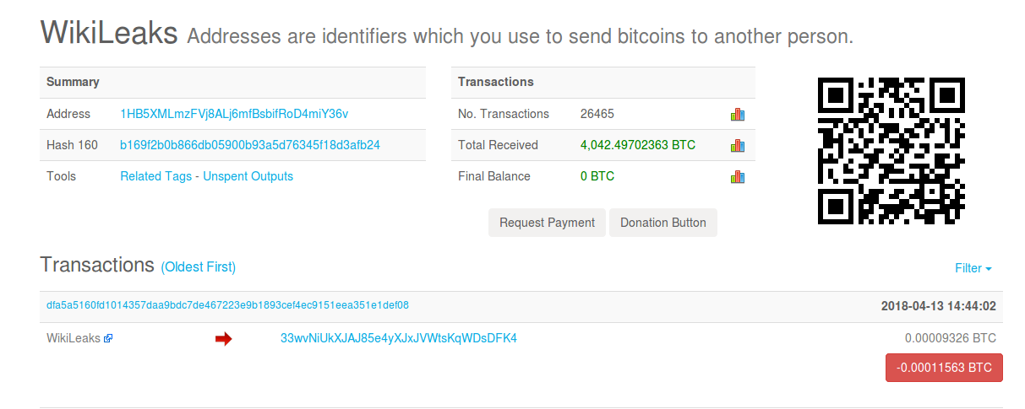
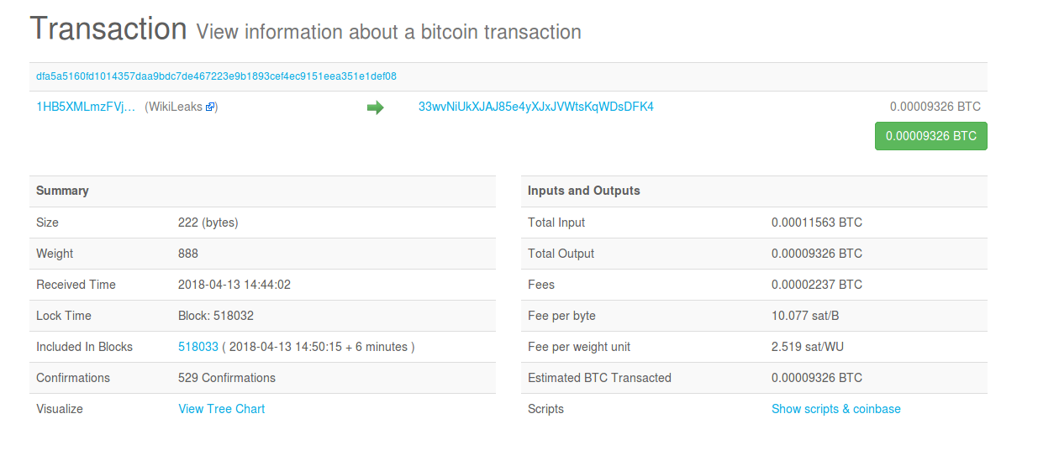
Blockchain Explorers and Forensics
Transaction example

Slide 18
Blockchain Explorers and Forensics
Most users get coins and cash out (to fiat) through cryptocurrency exchanges
Popular exchanges:
https://www.coinbase.com/
https://www.bitfinex.com/
https://www.gdax.com/
https://www.kraken.com/
The rest can be found here: https://cryptocoincharts.info/markets/info

Slide 19
Blockchain Generally
The technology of blockchain itself allows for the easy creation and distribution of immutable records over the Internet
Blockchains are useful in many areas:
IPFS and Storj are file-sharing services
Steemit is a blockchain-based social network with a currency as a reward for contributions
Namecoin is a blockchain implementation of DNS
Everledger and Block-Verify are anti-counterfeit systems
Musicians find smart contracts useful (Peer Tracks, Ujo)
http://scet.berkeley.edu/wp-content/uploads/BlockchainPaper.pdf

Slide 20
Permissioned Blockchains
Hyperledger, founded by the Linux Foundation is an umbrella project for general-purpose blockchains
Hyperledger Fabric by IBM has drawn a lot of attention for it’s “plug-and-play” approach to consensus, access control, and smart contracts
Specifically not a cryptocurrency. Instead of miners has “validating peers”
In finance, companies are using blockchains like these for authentication, transactions, and contracts
Chain is an on-going project with NASDAQ, CITI, Visa, State Street
Medici, Blockstream smart-contracts for stocks
http://scet.berkeley.edu/wp-content/uploads/BlockchainPaper.pdf
https://www.hyperledger.org/projects/fabric
https://www.zurich.ibm.com/dccl/papers/cachin_dccl.pdf
https://chain.com/sequence/

Slide 21
Blockchain in Healthcare
Permissioned blockchains could allow doctors and patients access to records efficiently and privately
Serves a digital identity system
As in Bitcoin, records and a log of access to them are encrypted for privacy, but distributed to keep integrity.
One such start-up powered by Hyperledger Fabric and Ethereum is Medicalchain
https://medicalchain.com/Medicalchain-Whitepaper-EN.pdf

Slide 22
Blockchain in Government
Natural fit for a public record system
Estonia has taken the lead on this, with other nations experimenting
Also a generalized platform: https://www.recordskeeper.co/
Secure e-Voting
Russia and many other countries have announced moving towards a blockchain-secured ballot box
https://www.coindesk.com/moscows-blockchain-voting-platform-adds-service-for-high-rise-neighbors/
Platforms and startups for general purpose:
https://polys.me
https://followmyvote.com/

Slide 23
E-Estonia
The Estonian government has taken the lead on implementing many technologies as part of its E-Governance initiative, integrating the KSI blockchain (X-Road) around 2012
Used for securing medical data
System for public records, laws, and court systems
i-Voting and e-Residency linked to digital PKI
Guardtime is the software company that developed the KSI blockchain and produces anti-tamper hardware, authentication, insurance security, and GDPR compliance tools on the same technology
https://e-estonia.com/
https://e-estonia.com/solutions/security-and-safety/ksi-blockchain/
https://guardtime.com/solutions
www.courtal.com

Slide 24
But let’s not lose our head...
In spite of the many benefits blockchain can add to the integrity and security of data, there are some important disadvantages:
Proofs-of-work and maintaining networks cost tons of electricity, CPU power, and money
Network speed and data syncing is difficult
Blockchains need widespread distribution to be effective
Software complexity, forks, and flaws
https://medium.com/nudjed/blockchain-advantage-and-disadvantages-e76dfde3bbc0

